Slide 1



Kisan Call Center
By:
Aman Jain
Debadutta Dey
Janmejay Dwivedi
Prakash Vishnani

Slide 2

Introduction
Kisan Call Center (KCC) offers excellent services by responding to the issues faced by farmers during agriculture.
KCC was created by Department of Agriculture & Cooperation (DAC), Ministry of Agriculture, Govt. of India on January 21, 2004.
KCC receives calls from farmers from different state of the country and resolves queries immediately.
Contact No:-1800-180-1551.

Slide 3
Problem Statement
Government wants to run the KCC effectively and in efficient manner but records are only stored and has never been mined.
Government wants to know:
  How much calls are received each state.
  Which agriculture sector and which state needs special attention.
  Which issues are enquired most so that farmers can be trained beforehand and if required those problems can be part of IVR.

Slide 4
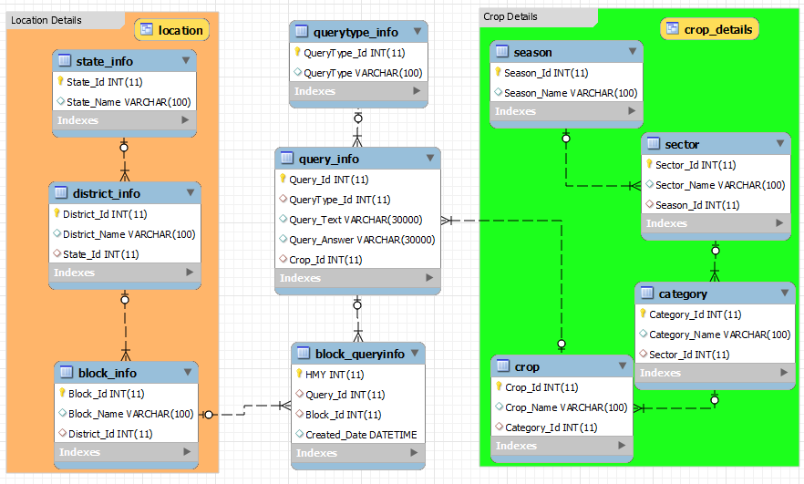
Entity Relationship Diagram

Slide 5
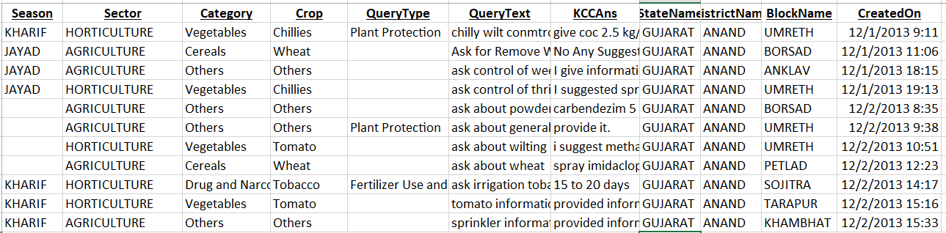

Initial data overview

Slide 6


Normalization
Checklist | Input | Output
First Normal Form
Each cell single valued
Entries in a column are of same type (not null)
Primary Key
Checklist | Input | Output
Second Normal Form
1NF
Non-key fully functional dependent on the PK
Checklist | Input | Output
Third Normal Form
2NF
Should not have Transitive Dependency
Checklist | Input | Output
BCNF
3NF
Non key should not derive primary key

Slide 7
Uploading Data
Data Source: data.gov.in
Data Preparation: Divided the initial table into multiple tables.
Data Cleanup: Removed invalid records from Query text column.
Data Loading: Created stored procedure to load data into multiple tables using staging table through csv file import.
Learning: loading files with huge number of rows into Mysql.

Slide 8
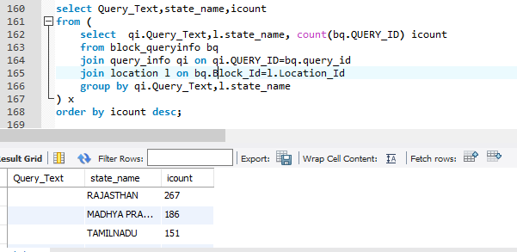
Data Analysis
Create a view to show the queries, state and count of calls in descending order of call count.

Slide 9
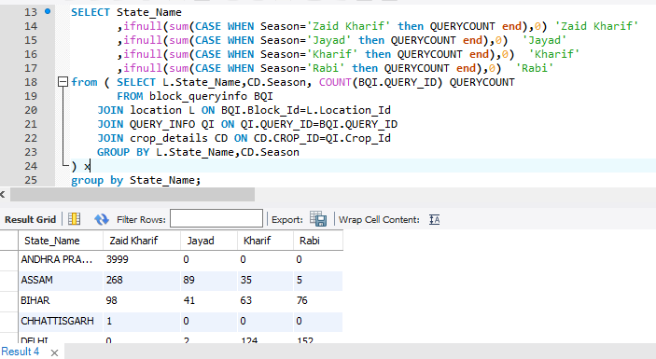
Data Analysis (Cont.)
Show the query count for each state for each season.

Slide 10
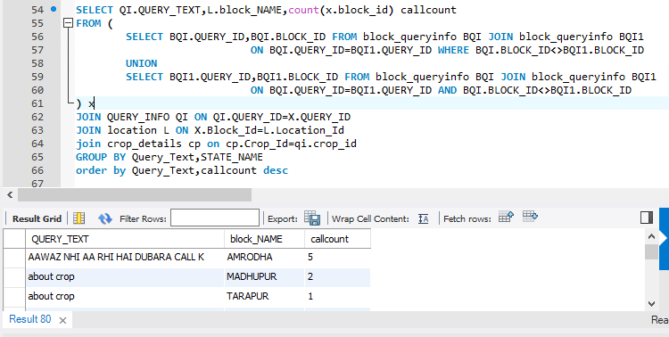
Data Analysis (Cont.)
List the query which is common among different block of a state.

Slide 11
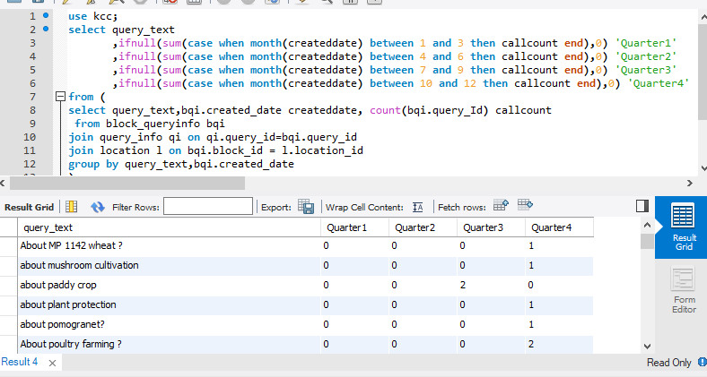
Data Analysis (Cont.)
Find out which query are mostly asked in which quarter.

Slide 12
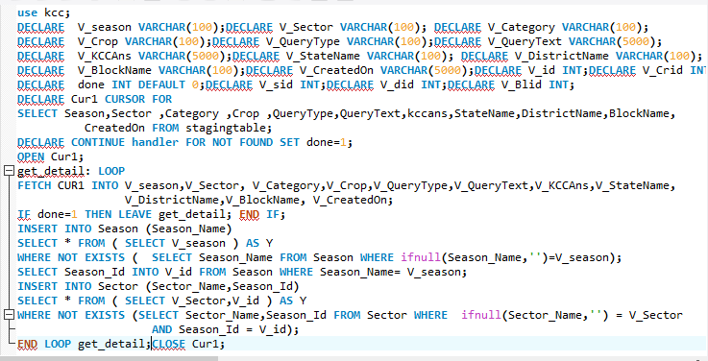
Data Analysis (Cont.)
Create a cursor which will insert records in two tables along with their primary key.

Slide 13
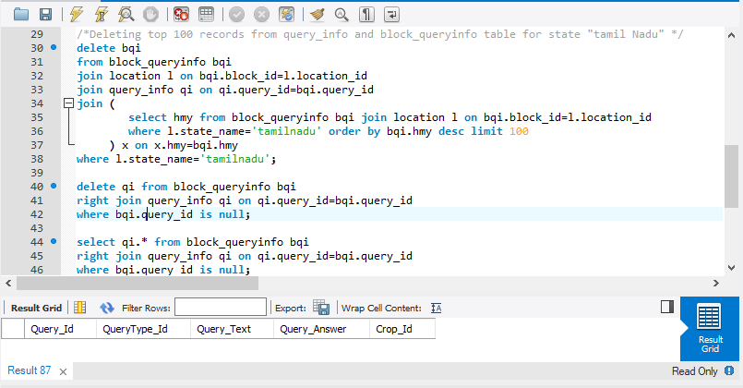
Data Analysis (Cont.)
Create a query to delete few (not all) records from two tables who has foreign key relationship between them without using primary key in where clause.

Slide 14
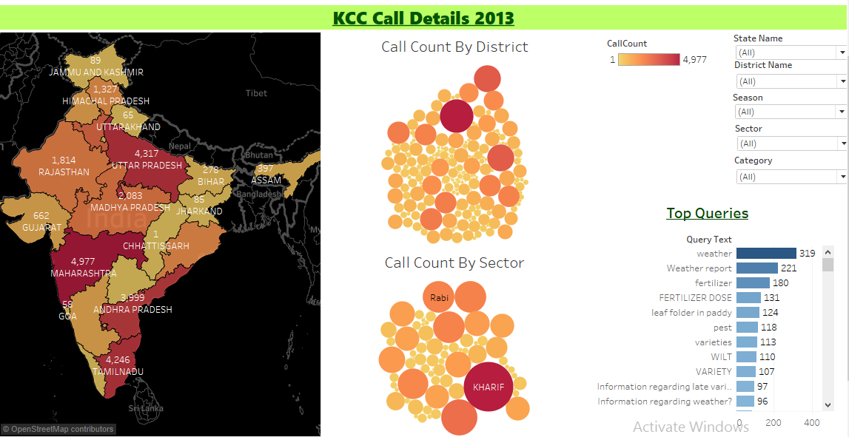
Data Visualization

Slide 15
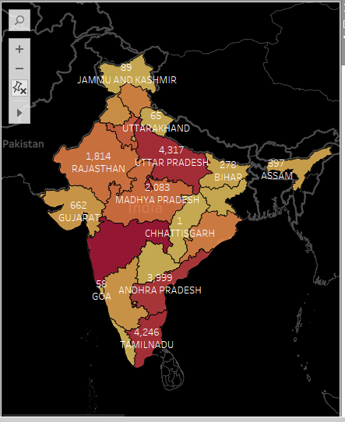
Solution 1
  Count of calls received from each state.

Slide 16
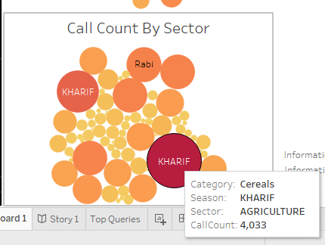
Solution 2
  Which sector and which state needs special attention.
Sector :- Agriculture
State:- Uttar Pradesh, Maharashtra, AP, Tamil Nadu

Slide 17
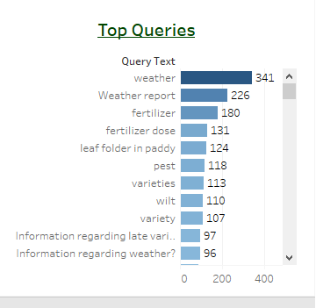
Solution 3
Which issues are enquired most so that farmers can be trained beforehand and if required those problems can be part of IVR.
Training Session
Fertilizer dose
Leaf folder in paddy
IVR
Weather information
Information regarding varieties of wheat, maize, chili etc.

Slide 18
Knowledge Gained
Data Wrangling process.
Data Normalization process.
Data Loading process to database.
For updates the SQL_SAFE_UPDATES flag had to be set (SET SQL_SAFE_ UPDATES = 1)
Regulating MySql buffer size.
Pulling records from database and visualizing in tableau.
Creating complex queries and aggregating records as required.
MYSQL connectivity with Tableau for Data Visualization.

Slide 19
Thank You

